Slide 1
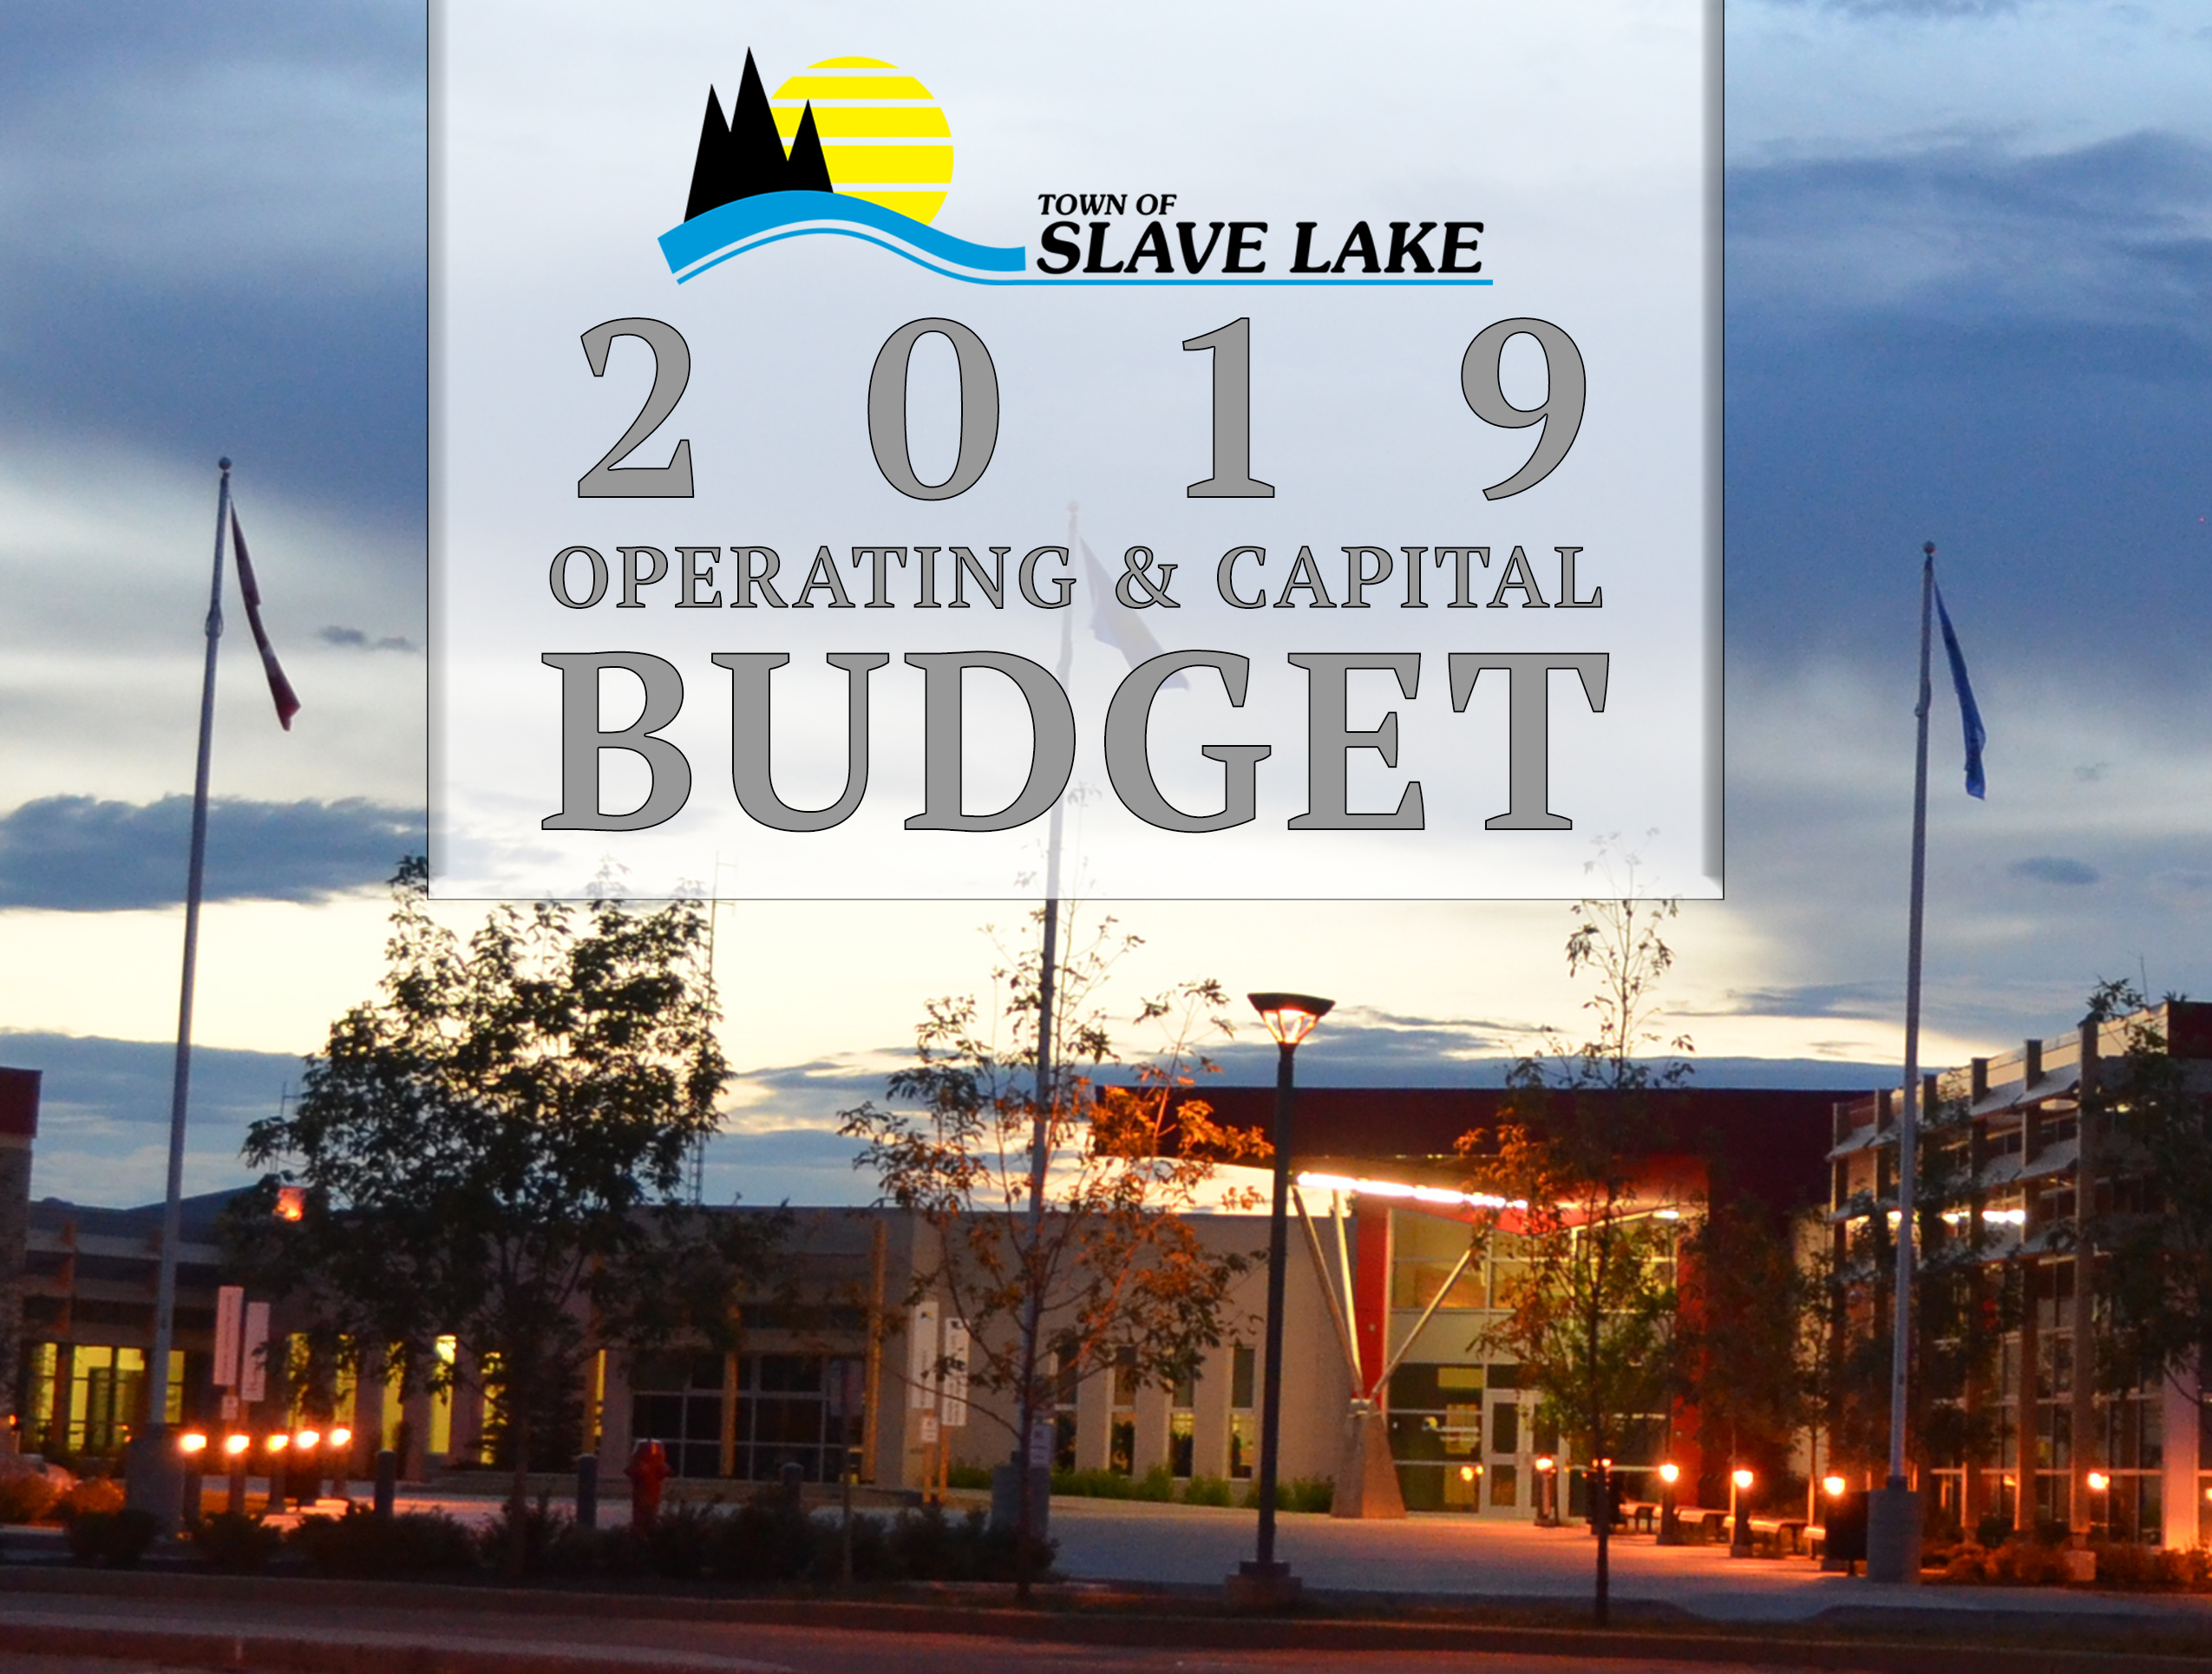

Slide 2

BUDGET BASICS -
WHAT EXACTLY IS A BUDGET?
  The budget is the Town’s plan and priorities expressed in dollars and cents
WHAT IS THE DIFFERENCE BETWEEN OPERATING AND CAPITAL BUDGETS?
  OPERATING BUDGET: The operating budget covers the daily expenses of delivering municipal services, such as fire protection, snow removal, park maintenance, RCMP, and library services to name a few. Operation is supported by taxes and commercial revenue such as the lease for the provincial government building. Utilities and cemeteries are funded separately through their fees.
  CAPITAL BUDGET: The capital budget covers constructing new assets and rebuilding assets. These assets include roads, water and sewer, equipment, and town facilities.

Slide 3

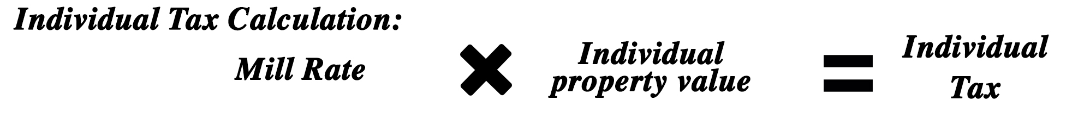
BUDGET BASICS - CHANGES IN THE MARKET VALUE
It is important to note that increases or decreases in assessment do not result in more or less income for the Town. Assessments determine the portion each property owner pays of the total budget. The Mill Rate determines how much you pay. The mill rate is set annually by Town Council to ensure that they have adequate funding to meet the budget.
THE CALCULATION IS AS FOLLOWS:

Slide 4
BUDGET BASICS – YOUR TAX BILL
Your tax bill may be either for non-residential or residential property. In Slave Lake the commercial tax rate is higher than the residential rate by about one third.
If your bill is for residential, you will notice that almost one third of the bill is for Schools and Seniors. These rates are set by the Provincial Government. The Town collects them, but forwards them on to the province. We have no control of increases to these.
In 2018 there was a special tax of $215 for road maintenance applied to each parcel of taxable land within the Town of Slave Lake. This special tax expired as of December 31, 2018. There will be no special tax or local improvement levy applied to any property in the Town of Slave Lake for the 2019 tax year. In 2019, a portion of your property taxes will go towards the road reserves.
This year Council has decided to transfer $400,000 to that reserve. This is not a special tax but is already included in your property tax bill.

Slide 5
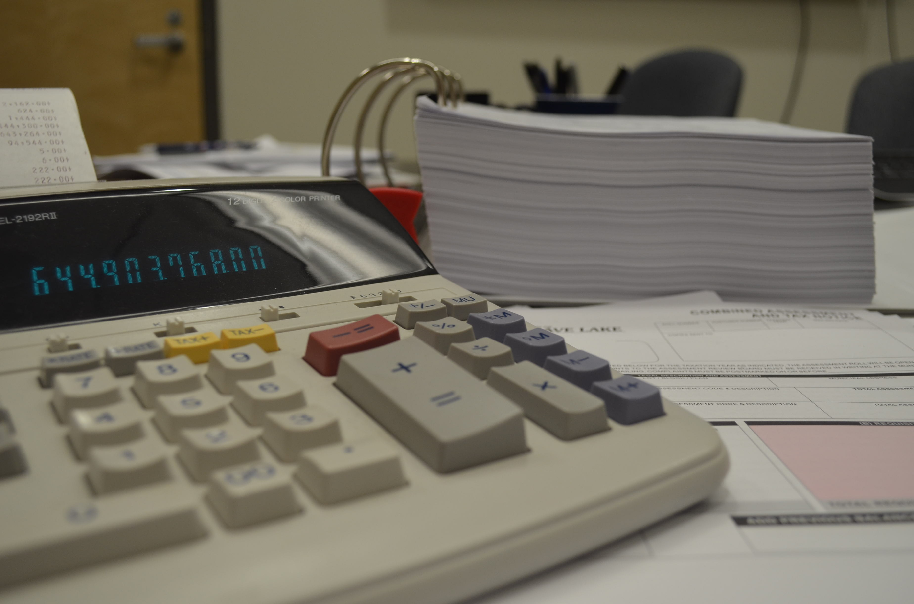
OPERATING BUDGET
When crafting the 2019 Operating Budget, Administration and Council kept in mind the Vision of Slave Lake.
“Slave Lake is committed to building opportunities by growing business, industry and population, while promoting ourselves and our exceptional quality of life.”
The proposed 2019 Budget reflects the cost of maintaining Slave Lake’s core services, programs and infrastructure that citizens rely on every day, as well as new initiatives and improvements to current programs that will advance Council’s strategic vision.

Slide 6
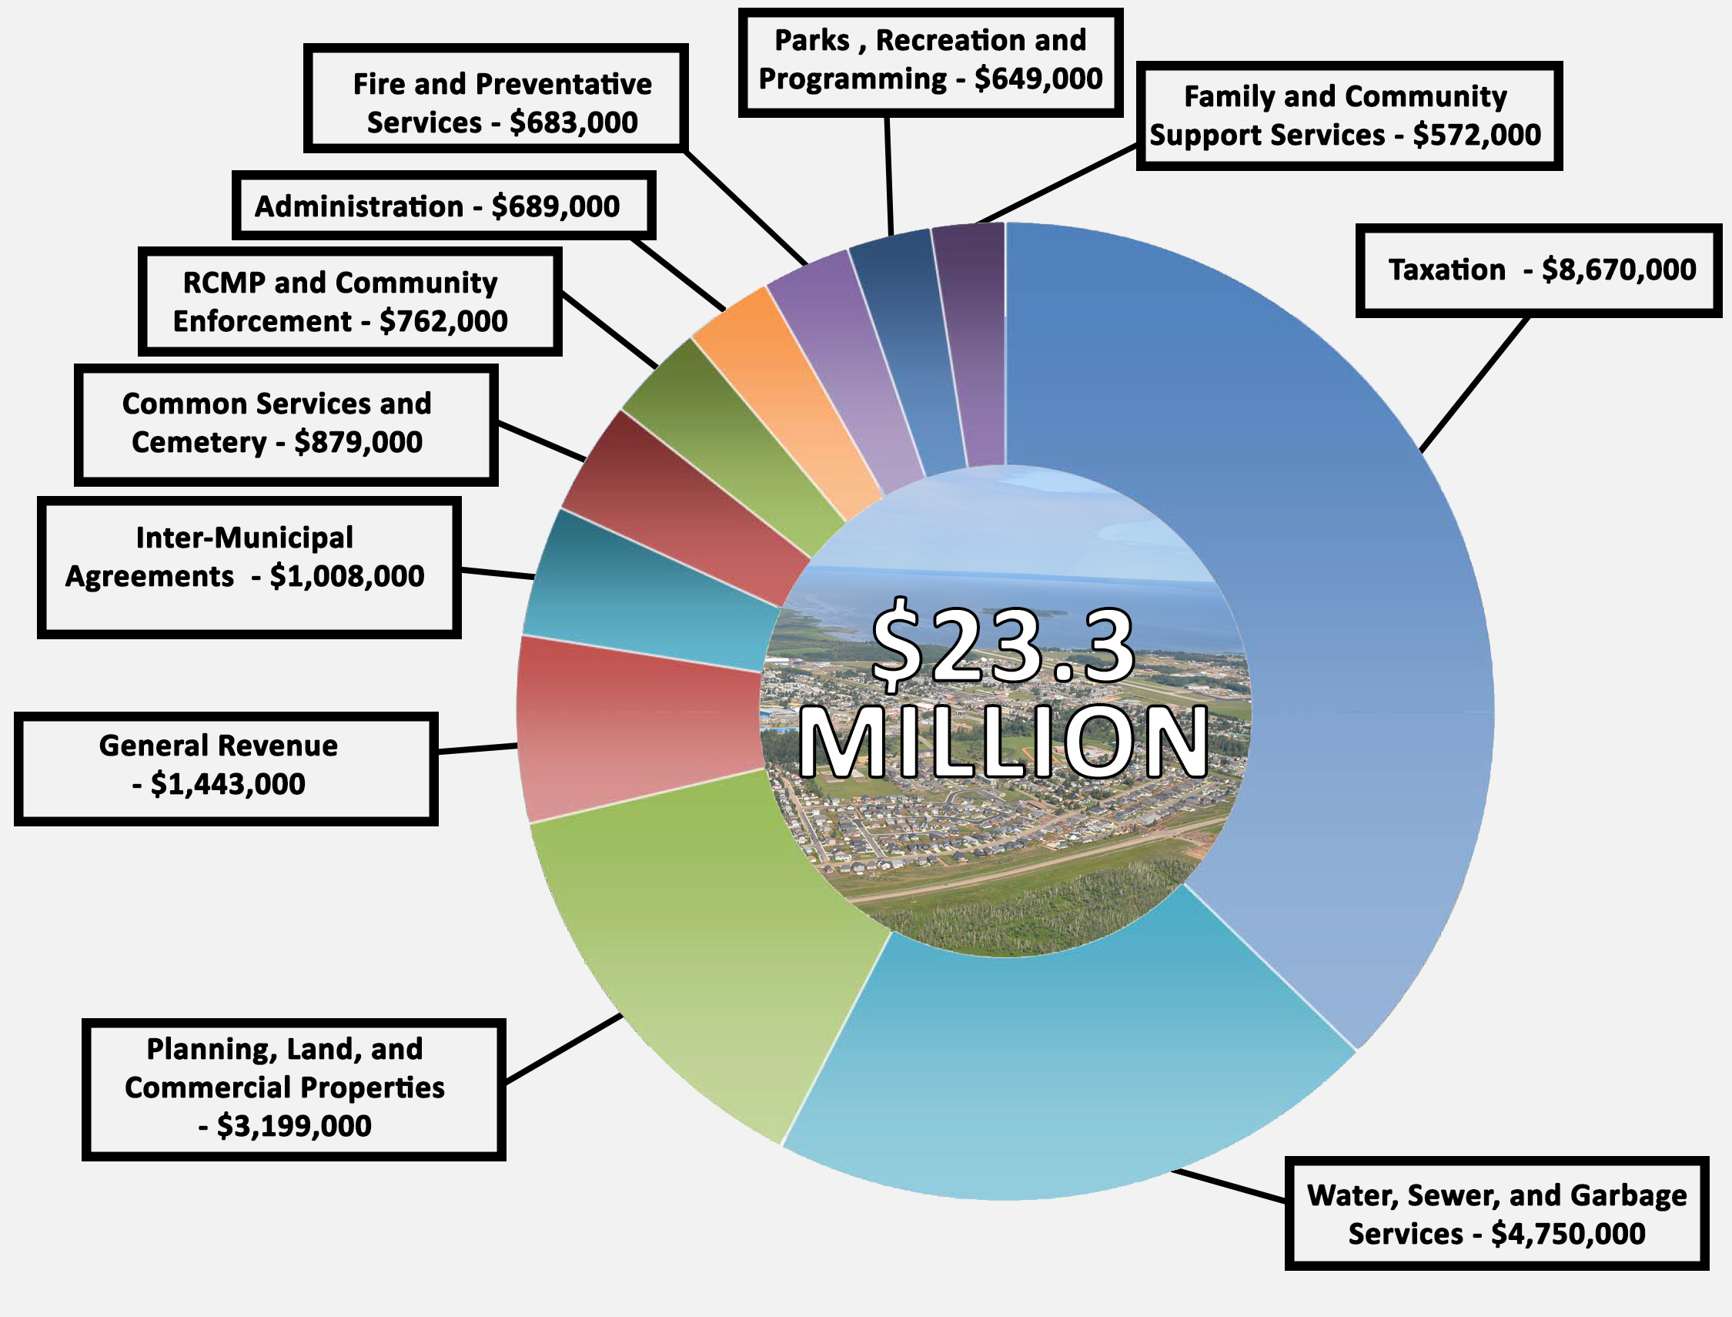
OPERATING BUDGET– SOURCES OF REVENUE
1) Note that numbers are rounded to the nearest $1,000 and do not include Provincial requisitions

Slide 7
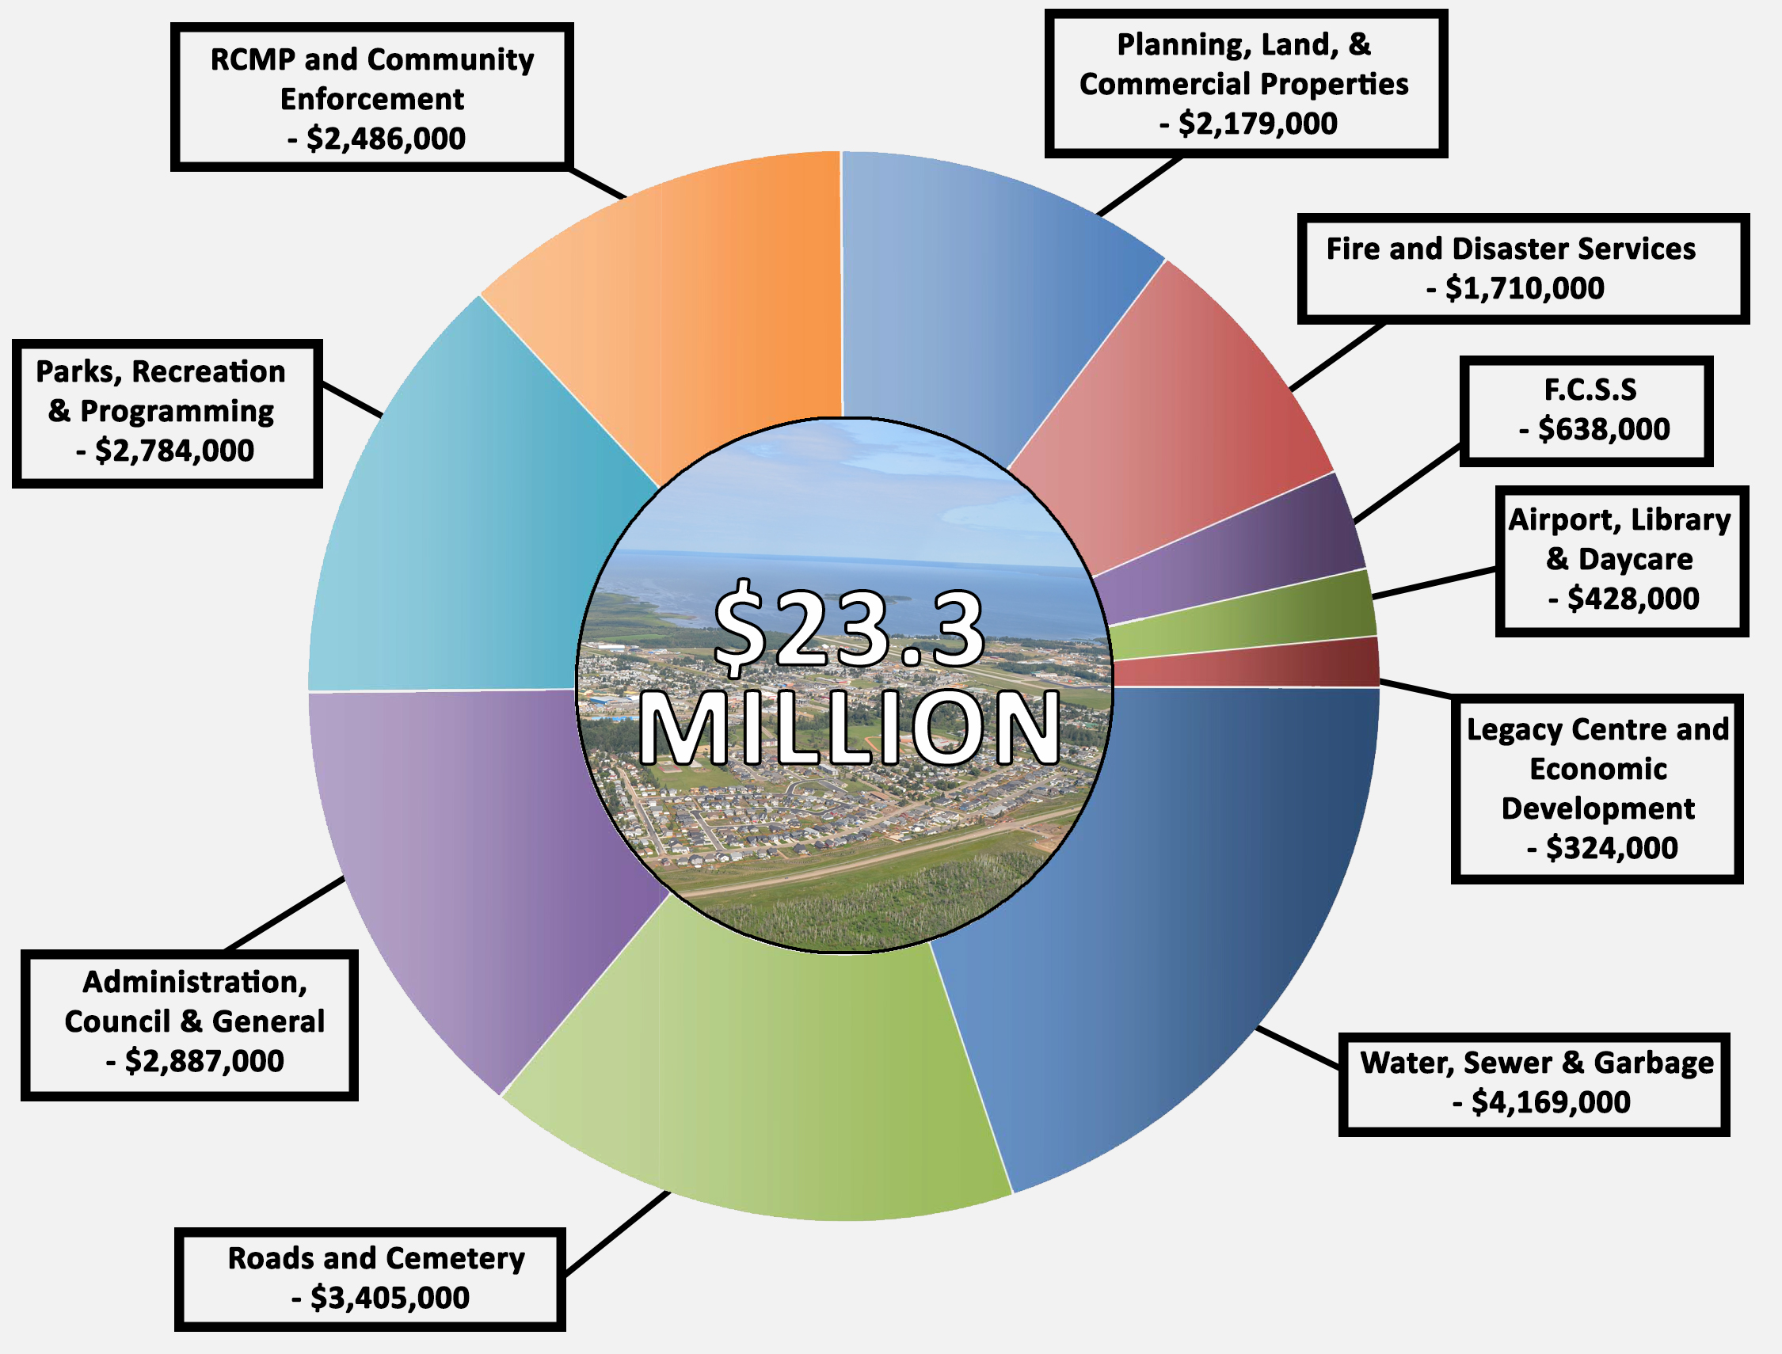
OPERATING BUDGET– WHERE DOES THE FUNDING GO?
1) ** Fire Department net cost to the Town of Slave Lake is $600,000
2) Note that numbers are rounded to the nearest $1,000 and do not include amortization
3) Not shown on graph Principal Payments - $2,302,000

Slide 8

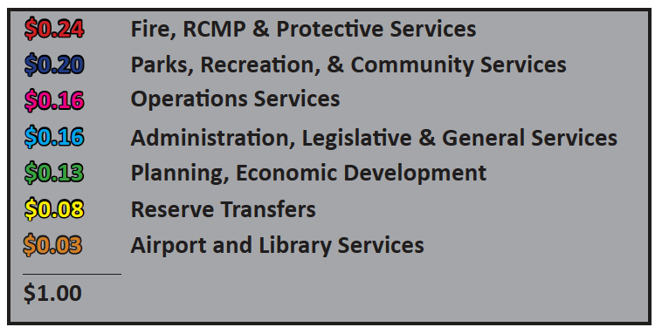
OPERATING BUDGET– WHAT DOES $1.00 OF TAXES BUY?

Slide 9
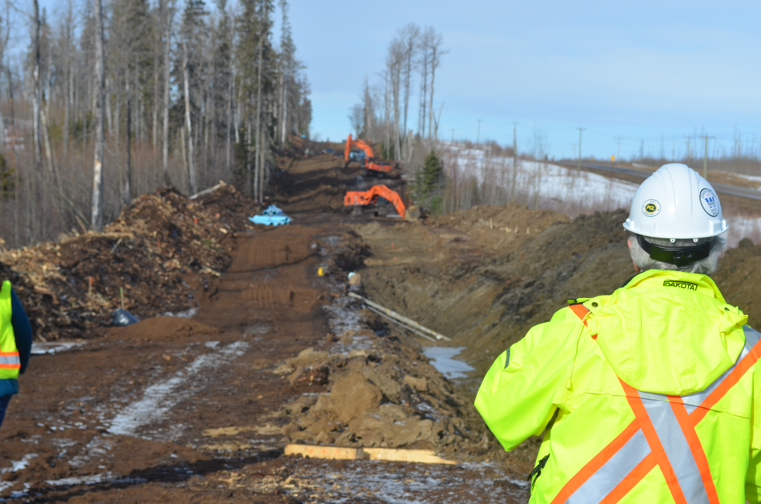
CAPITAL BUDGET
Town Council and Administration look carefully at the Capital requirements and pick the most critical ones each year.
Selection depends on how critical they are and also if alternative funding is available. 2019 is largely a year of completion for two major projects (Raw Water Line and Sewage Treatment) and upgrading aging infrastructure.
It is a top priority to provide residents with reliable and excellent water and sewer. We have done road rebuild work every year since 2011 and have taken a year off to restore our road building reserves.

Slide 10
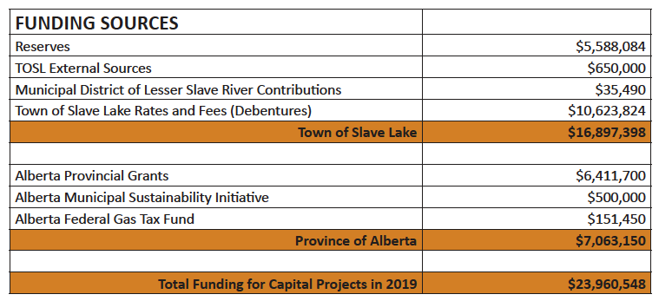
CAPITAL BUDGET– FUNDING COMES FROM

Slide 11
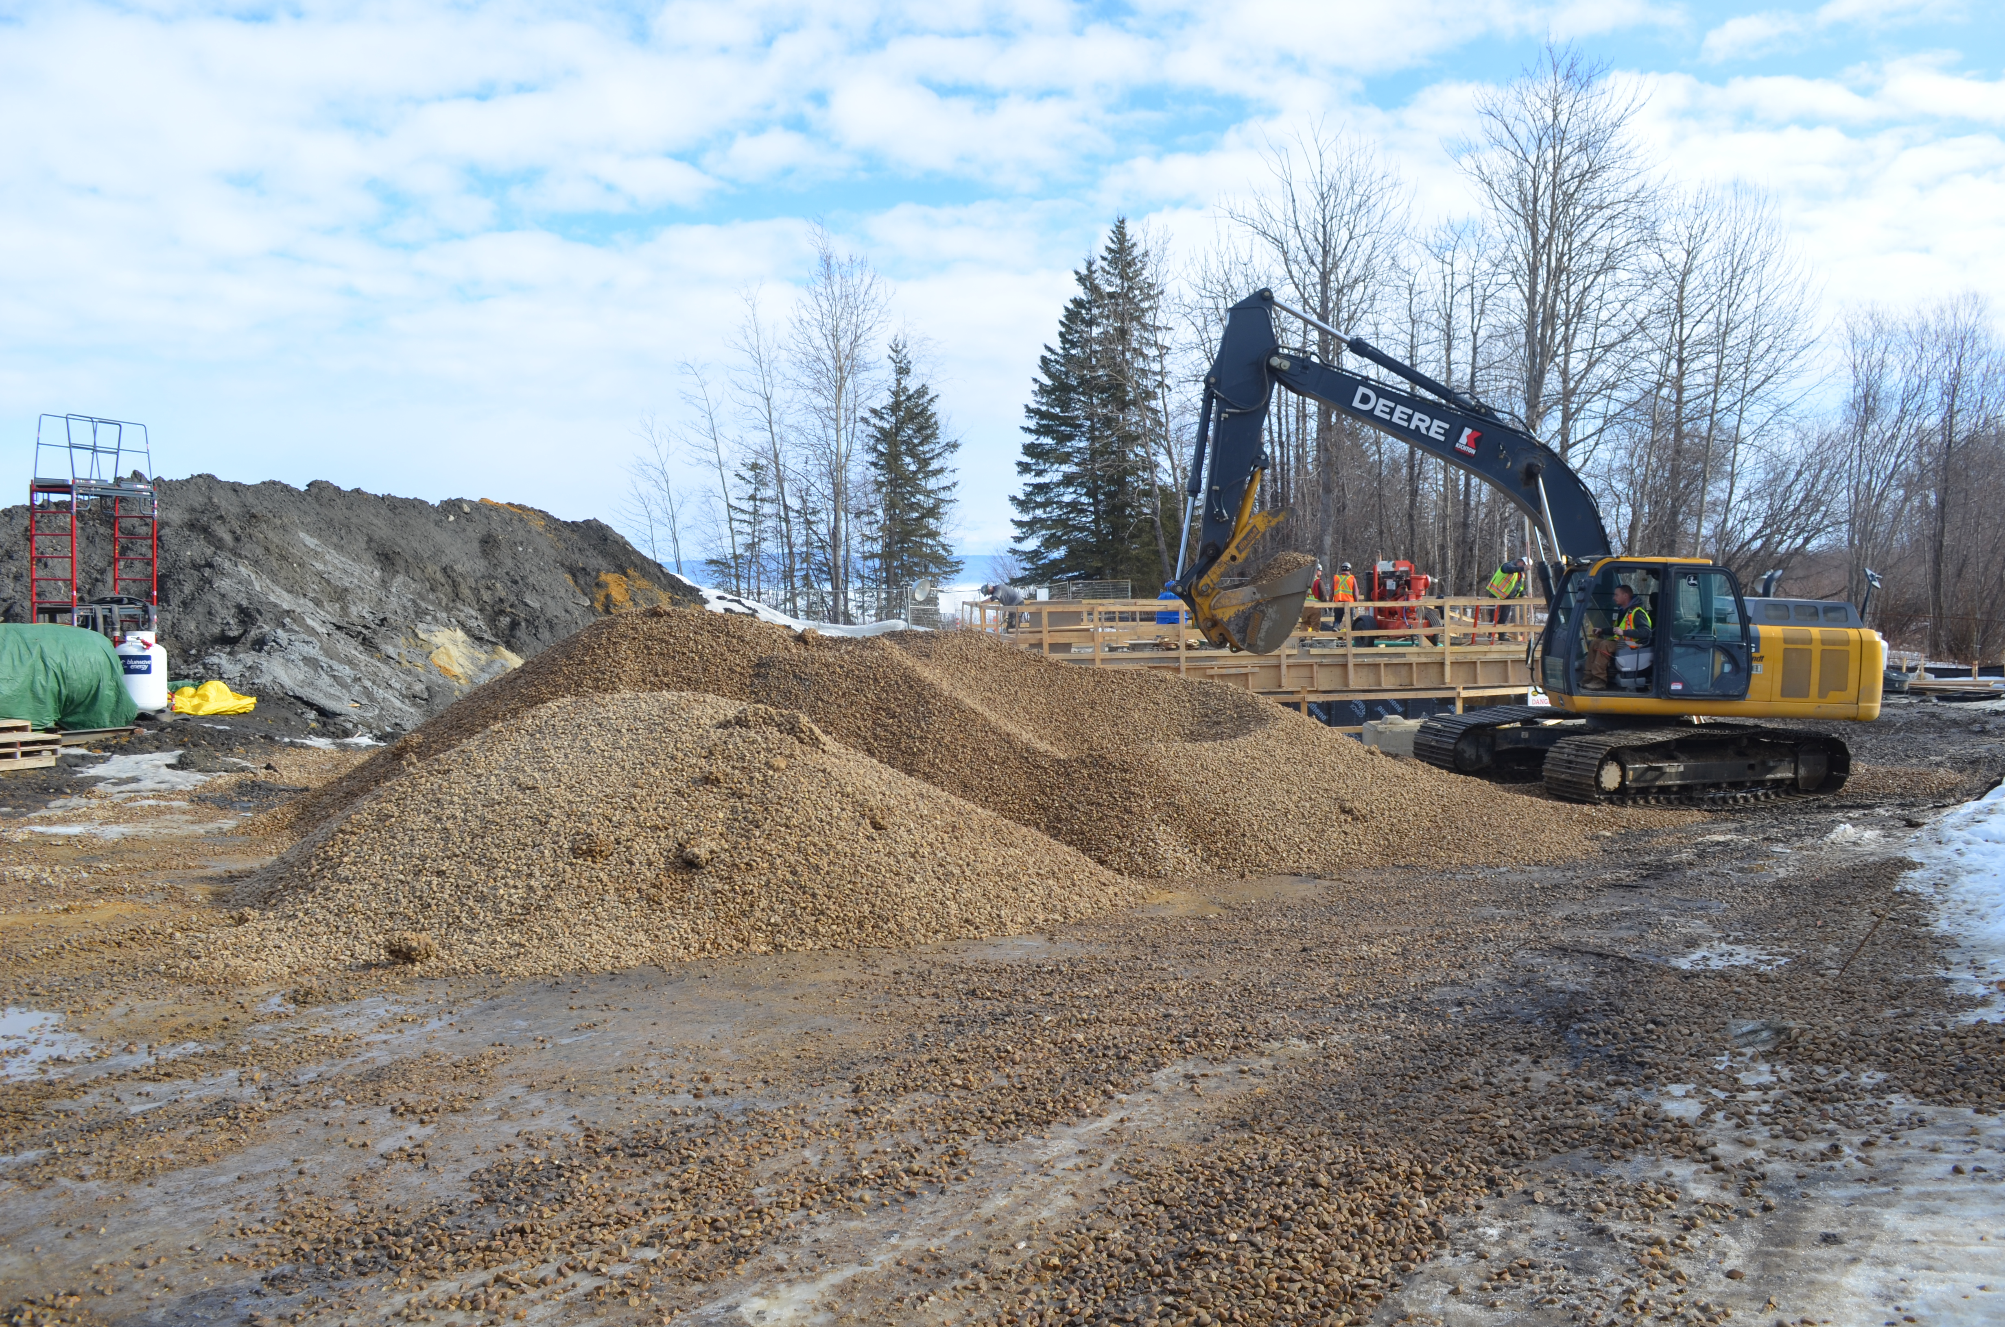
CAPITAL BUDGET- MAJOR CAPITAL PROJECTS
WATER & SEWER
Clean drinking water and sewage treatment are the backbone of every community.
These pieces of infrastructure have serviced the needs of past generations, continue to service the current generation and will, with continuing investment, service the needs of future generations.
In every facet of our lives we require access to clean drinking water and the ability to properly dispose of our waste.

Slide 12
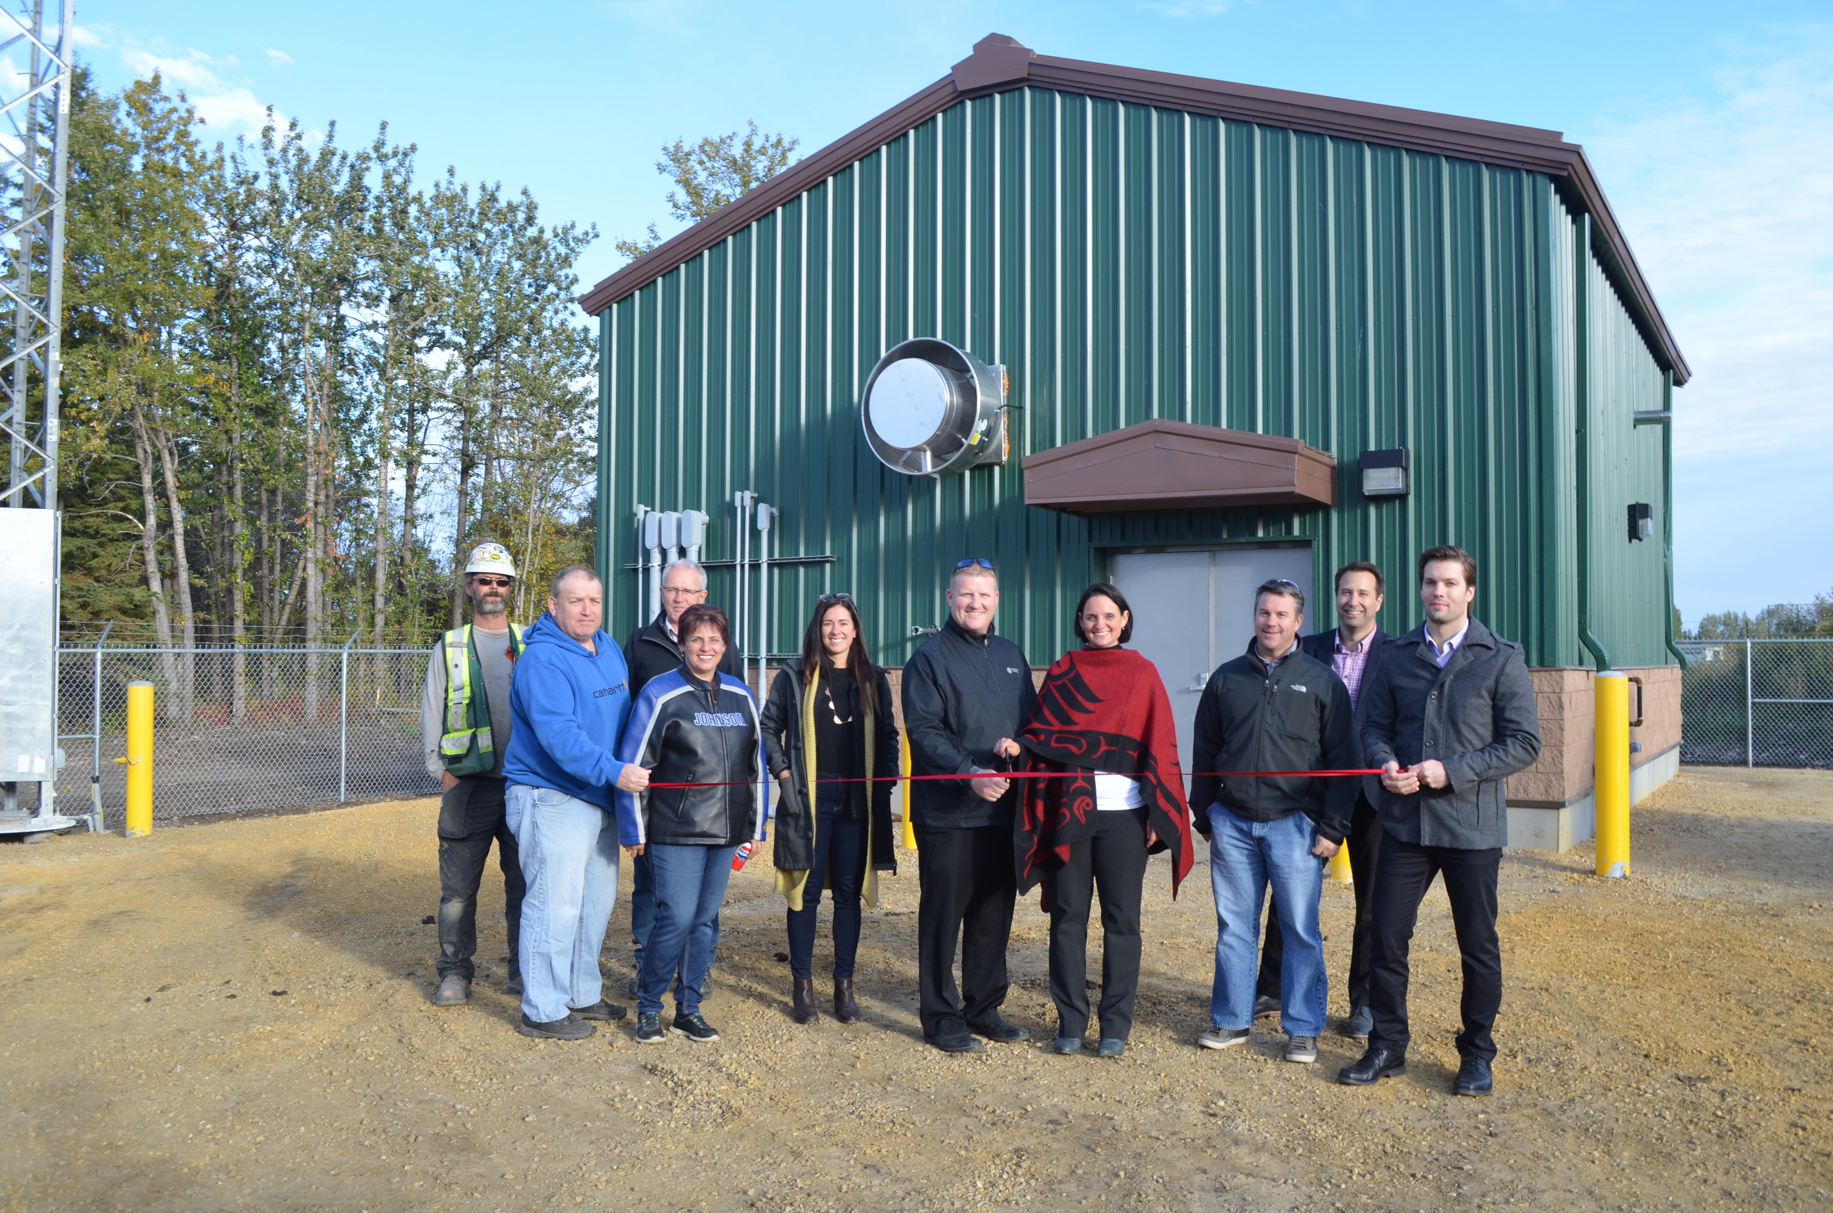
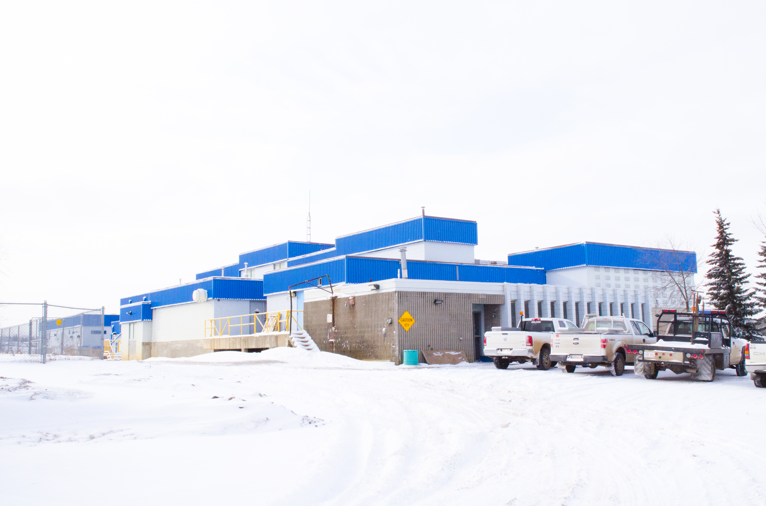
CAPITAL BUDGET- MAJOR CAPITAL PROJECTS
RAW WATER LINE PROJECT
COST - $18,600,000
WATER TREATMENT PLANT OFFICE UPGRADE
COST - $1,300,000
A new water intake is being constructed in Widewater which will draw water from a deeper area of the lake. This will eliminate problems treating water during spring runoff and during storms. Also it will minimize risk due to contamination spills into the lake and from Blue-Green Algae.
The water treatment lab and office is over 40 years old. Upgrades will be done to modernize the facility, allowing it to meet current needs and requirements for testing of the water and sewage treatment processes.

Slide 13
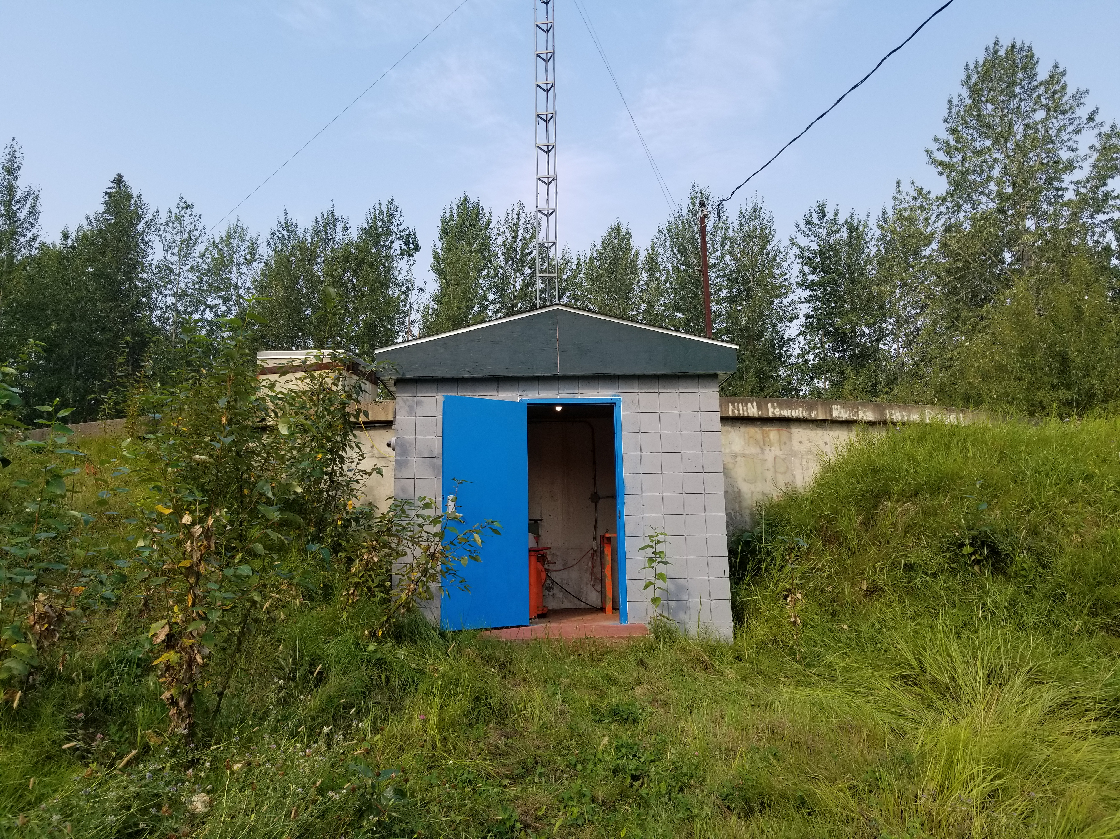
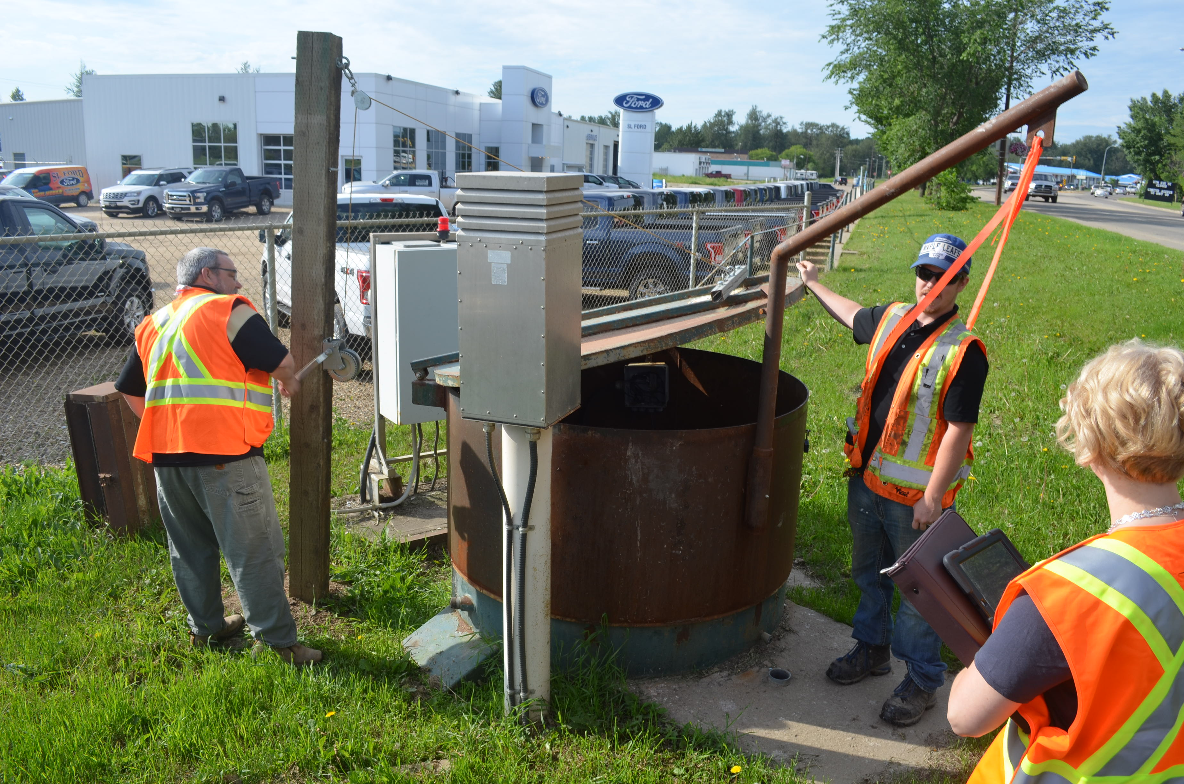
CAPITAL BUDGET- MAJOR CAPITAL PROJECTS
RESERVOIR PIPING REPLACEMENT
COST - $1,700,000
LIFT STATION UPGRADE
COST - $50,000
The Towns upper water reservoir dates back to when the first water system was installed in the early 1960’s. The piping, electrical, and controls will be modernized and brought to current standards.
The sewage lift station on Main Street across from the Library was part of the Town’s original sewage system and will be replaced in order to improve reliability. In 2019 council has budgeted $50,000 for engineering and design of the new lift station. Administration has proposed construction to start in 2020.

Slide 14
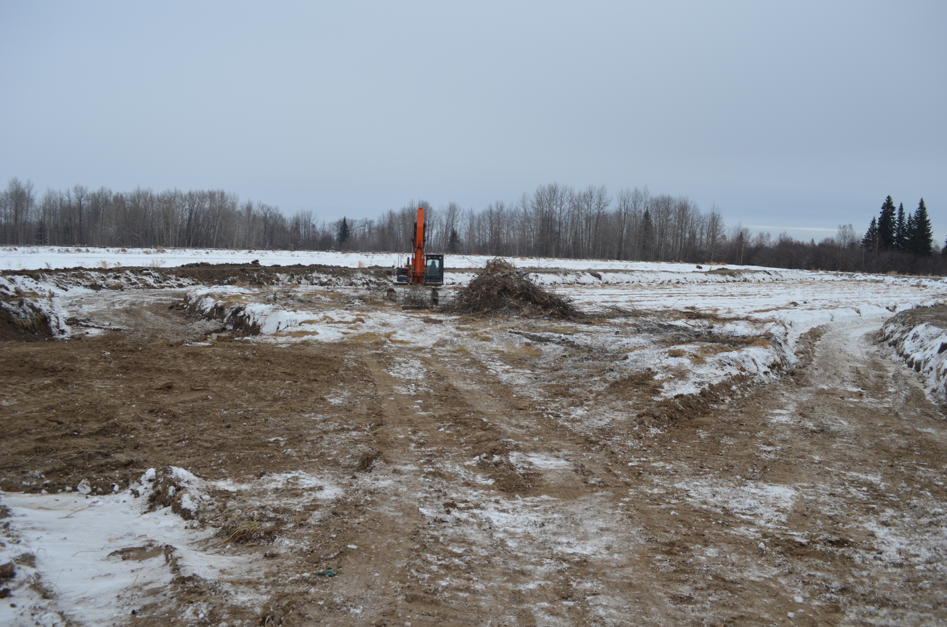
CAPITAL BUDGET- MAJOR CAPITAL PROJECTS
SEWAGE TREATMENT UPGRADE
COST - $14,150,000
The sewage treatment system dates back to the 1960’s. It must be modernized in order to meet current provincial effluent treatment standards.

Slide 15
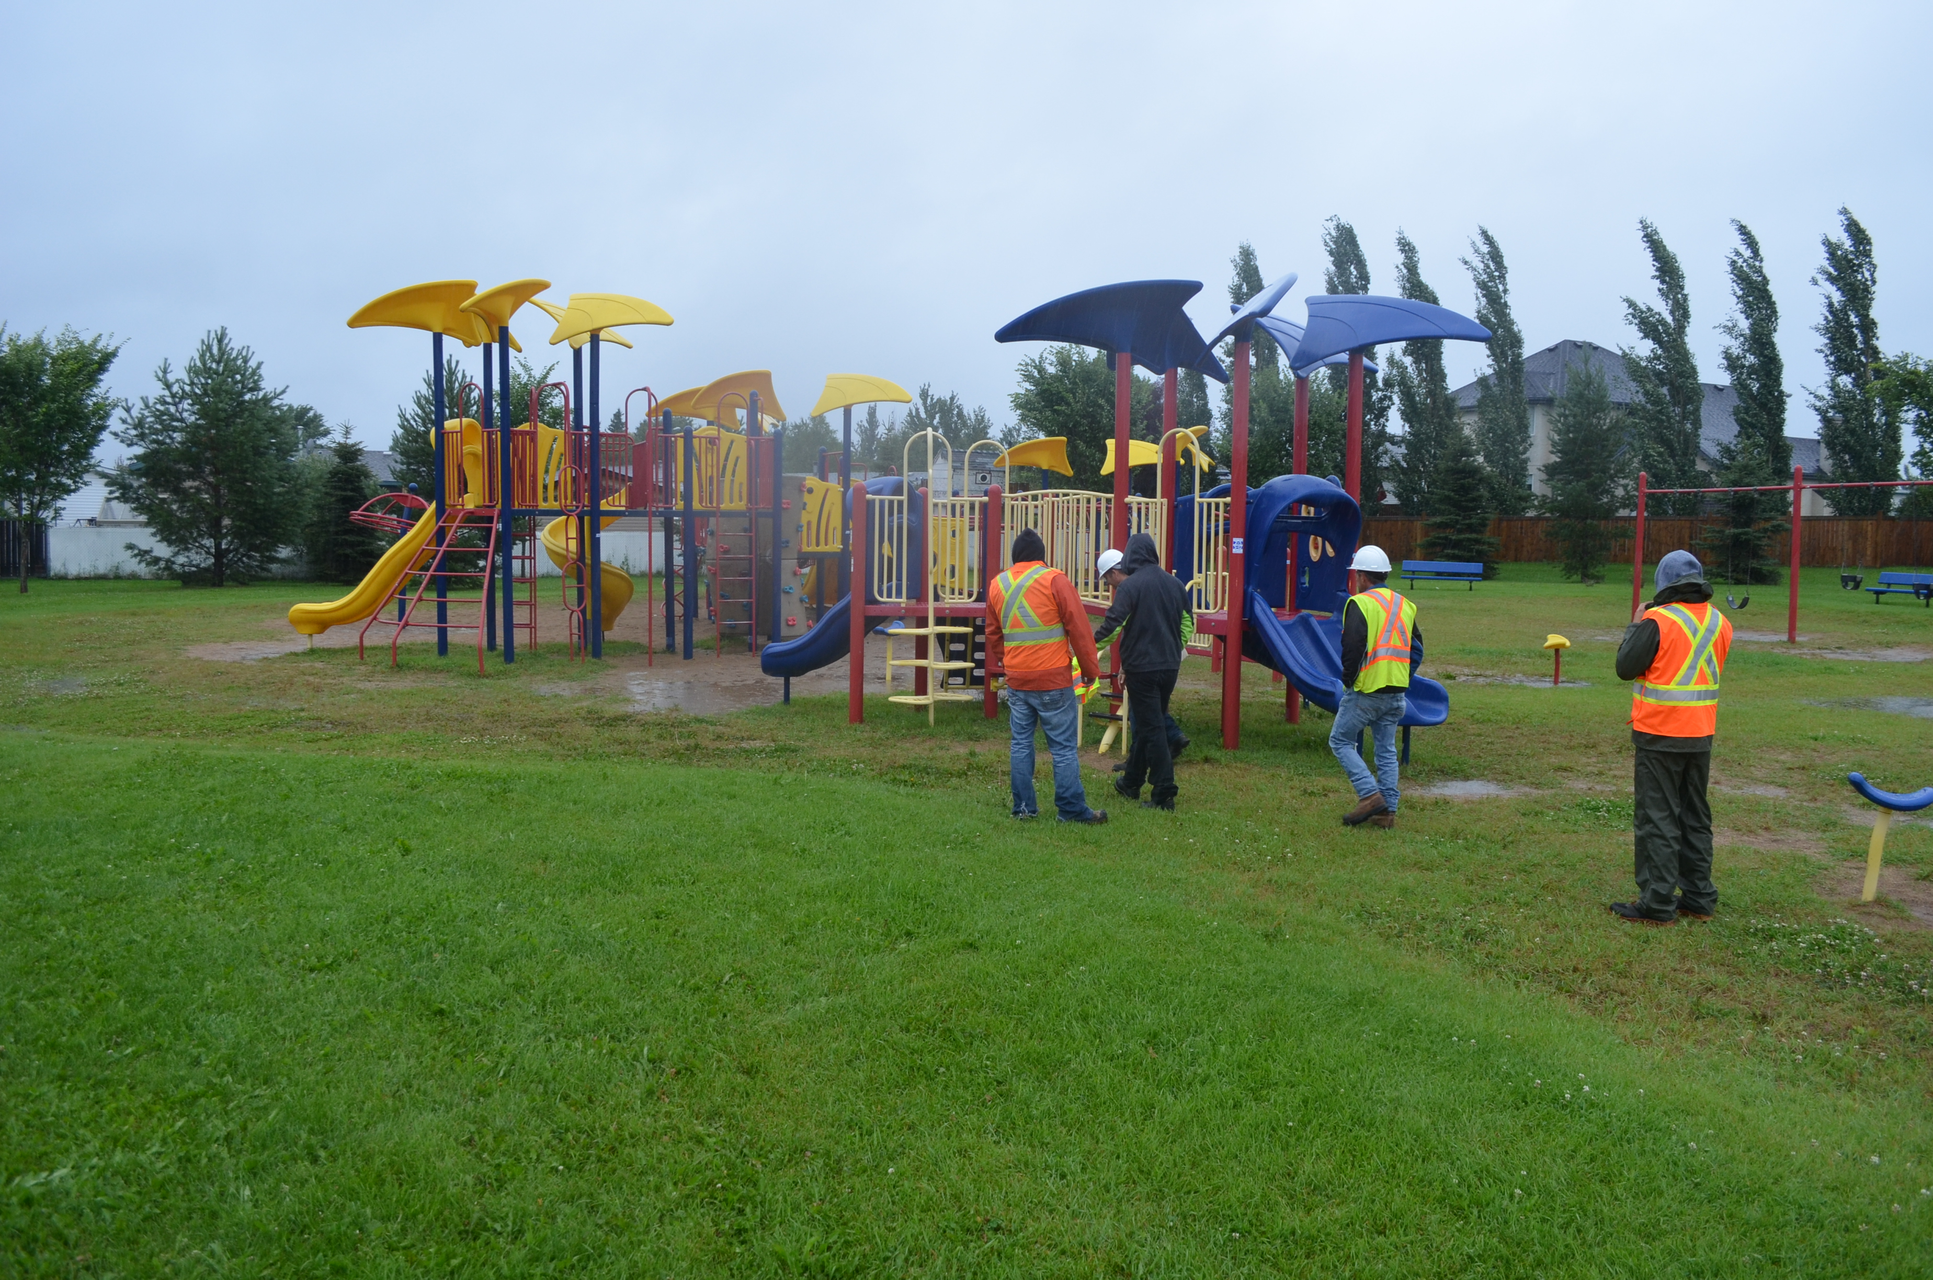
CAPITAL BUDGET- MAJOR CAPITAL PROJECTS
PARKS AND RECREATION
Parks and recreation facilities can promote active lifestyles, build healthy communities, and lower health care costs for residents of all ages. The Town of Slave Lake is investing in our parks and trail system to promote our exceptional quality of life.
Funding for Parks is provided by photo radar proceeds and provincial grants.

Slide 16
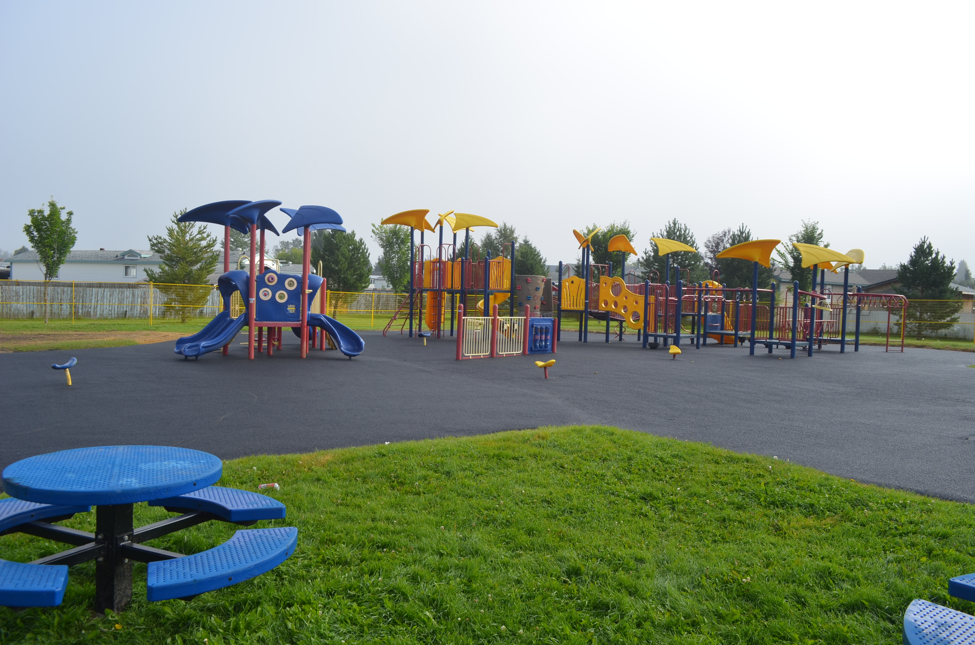
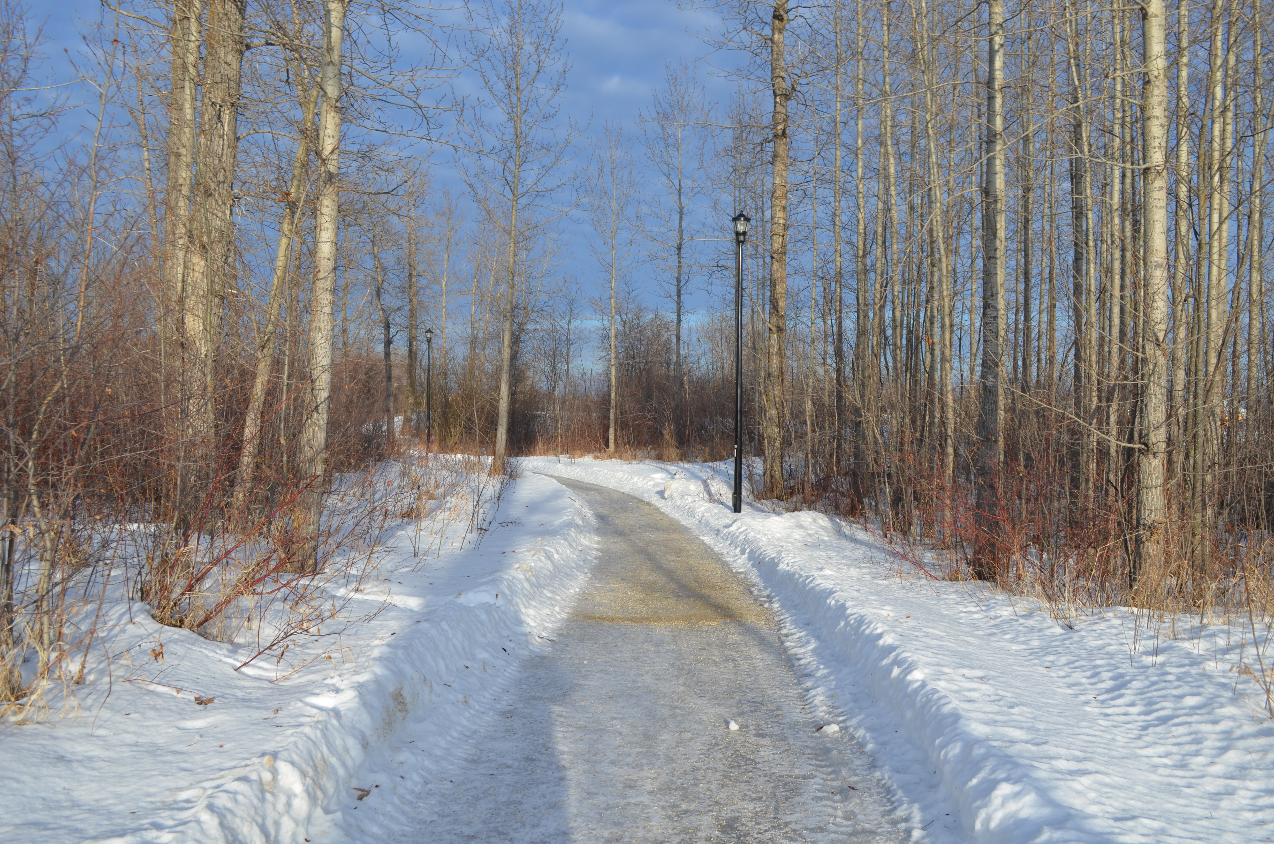
CAPITAL BUDGET- MAJOR CAPITAL PROJECTS
BARTON PARK UPGRADE
COST - $211,500
ALLAIRE TRAIL UPGRADES
COST - $60,000
Continuing improvement will be made to the major quadrant park in the southwest. This includes constructing an actual parking lot, that will be larger and better defined, built to a gravel parking lot standard. Also includes accessible paths linking the playground to 2 Ave. S.W. (and the parking lot), 7 St. S.W. & 6 Ave S.W.
The flood in June 2018 washed away the creek bank so that the top of bank is very close to the Allarie Trails in two locations: behind the Northern Lakes College and behind Roland Michener Secondary School. This project will entail removing the sections of trail that are very close to the top of bank and relocating those sections further away from the bank. Relocated trails will be paved.

Slide 17
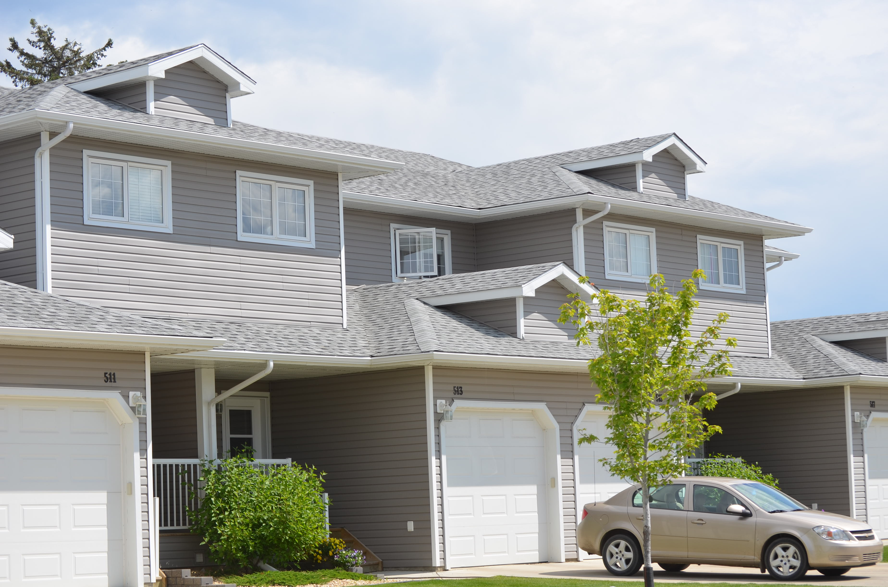
PROPOSED BUDGET CHANGES
The overall budget increase for 2019 is 2.5%. However, the average homeowner will see no increase on his tax bill. Owners of homes and businesses above the average will see an increase while if your property is below the average value you will actually see a decrease.
Council and administration have worked hard to try and reduce costs and cut spending wherever possible. However they have also considered what residents want and expect for municipal services.
The 2019 budget reflects a number of continuous improvement efforts, including reductions throughout the organization and also increased revenue opportunities.

Slide 18
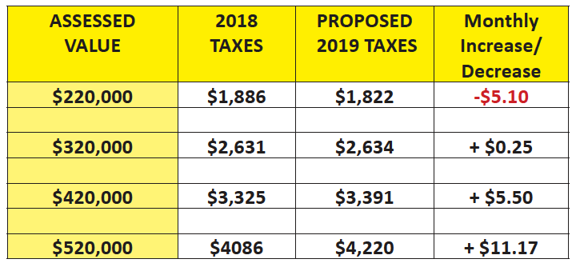
PROPOSED BUDGET CHANGES – ASSESSED VALUE IMPACT

Slide 19
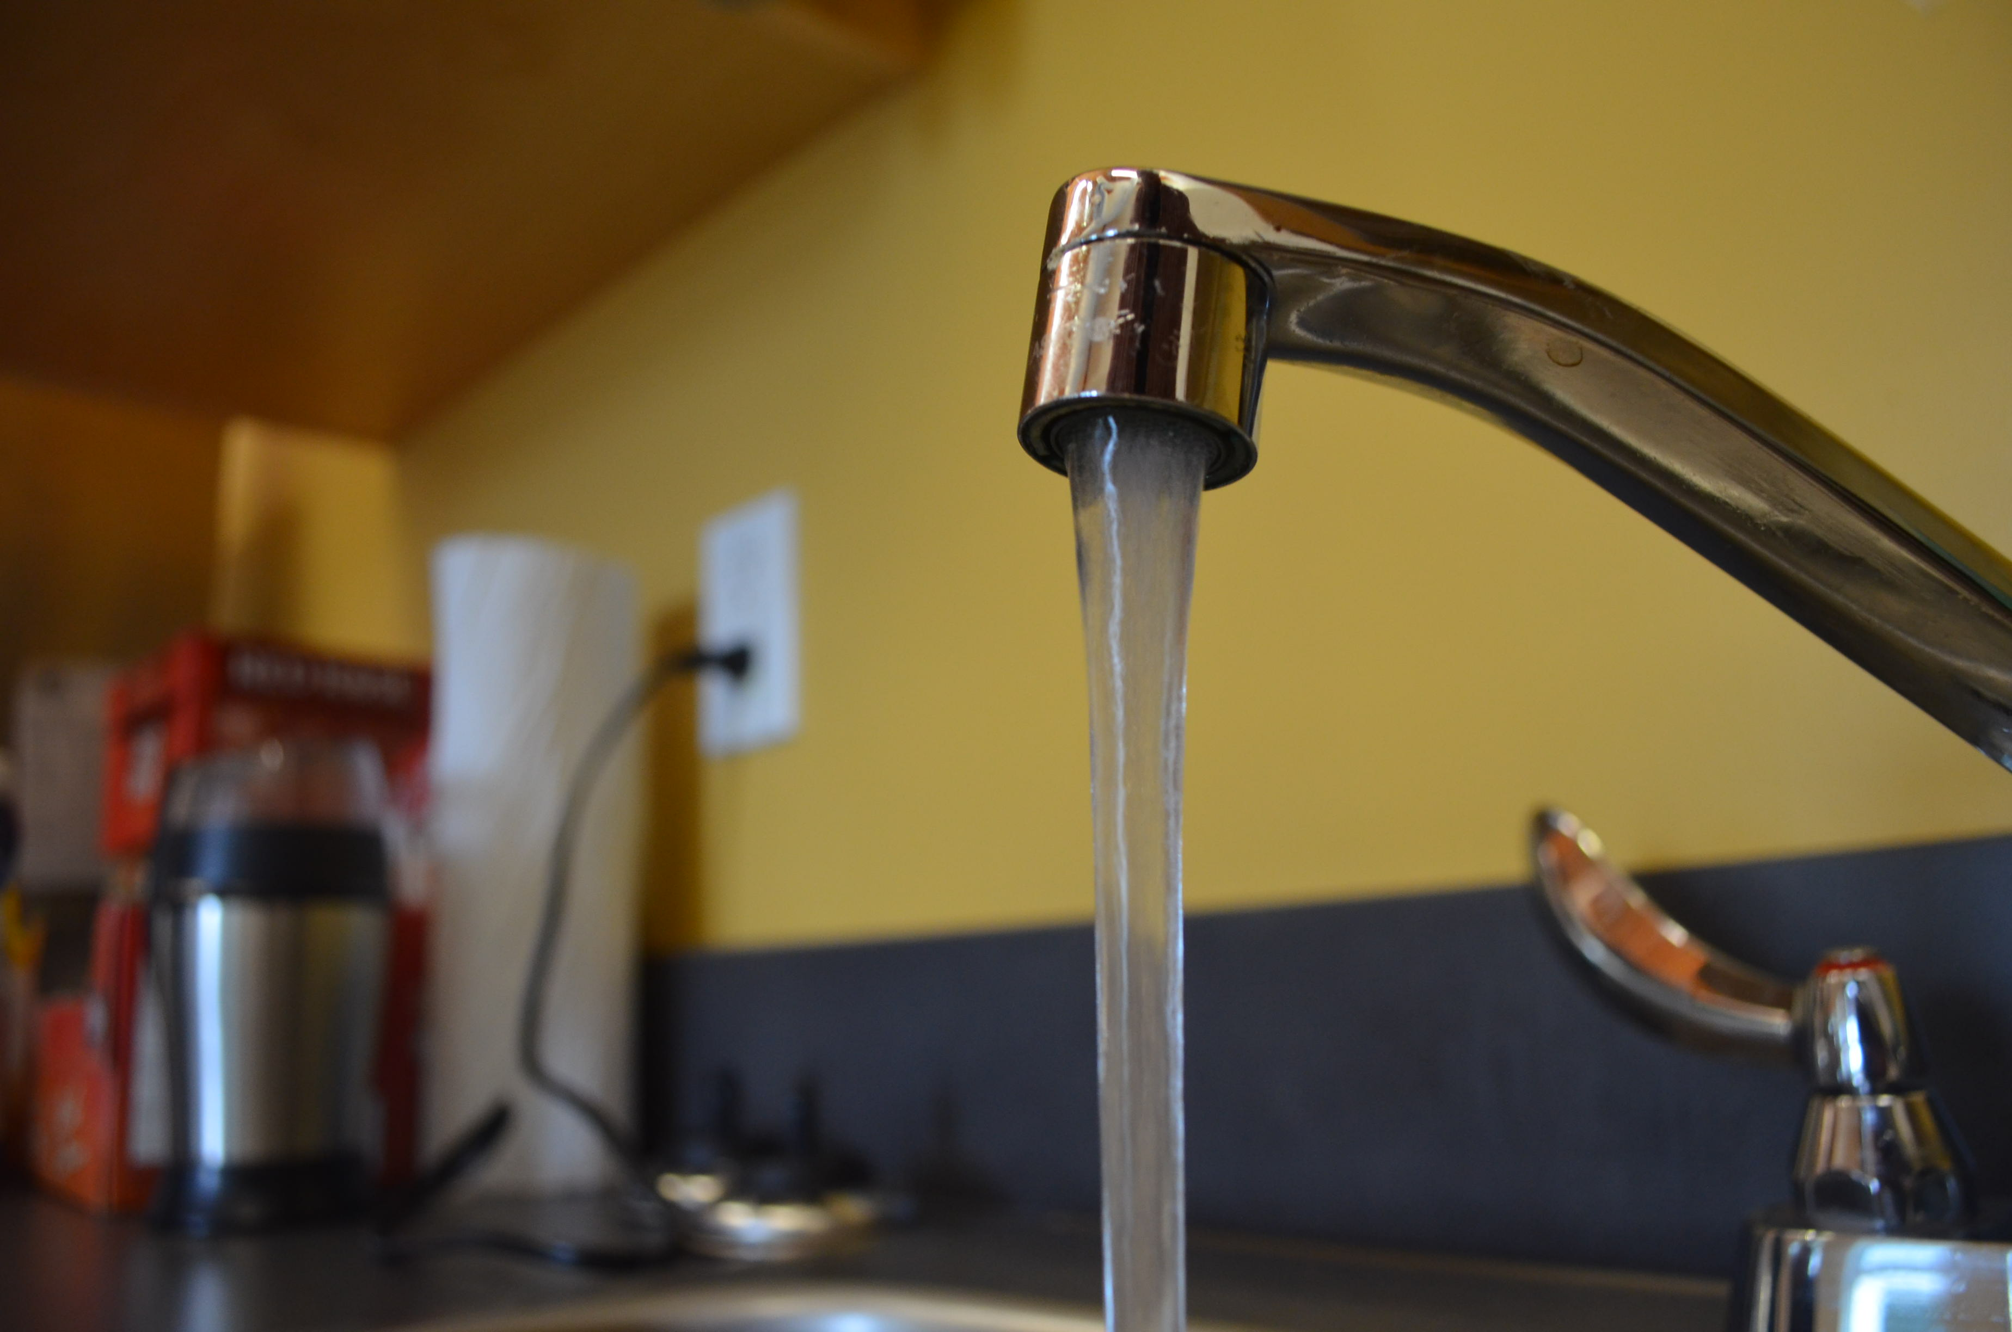
UTILITIES
Utility rate increases are primarily driven by the need to take out a debenture for the new Raw Water Line and the sewage treatment upgrade.
Surveys have been done to determine whether residents would like to save money by eliminating one of the 3 methods available for recycle.
It was found that residents feel that the three recycling services currently provided, curb-side recycling, the town recycling centre, and the recycling centre at the landfill, provide good value to the town as a whole.
Although utilities are included in the annual budget, the Utility rates will not be finalized until the Utility Rate Bylaw is revised in March.

Slide 20
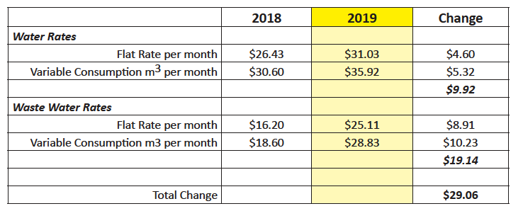
UTILITIES – INCREASE BREAKDOWN

Slide 21
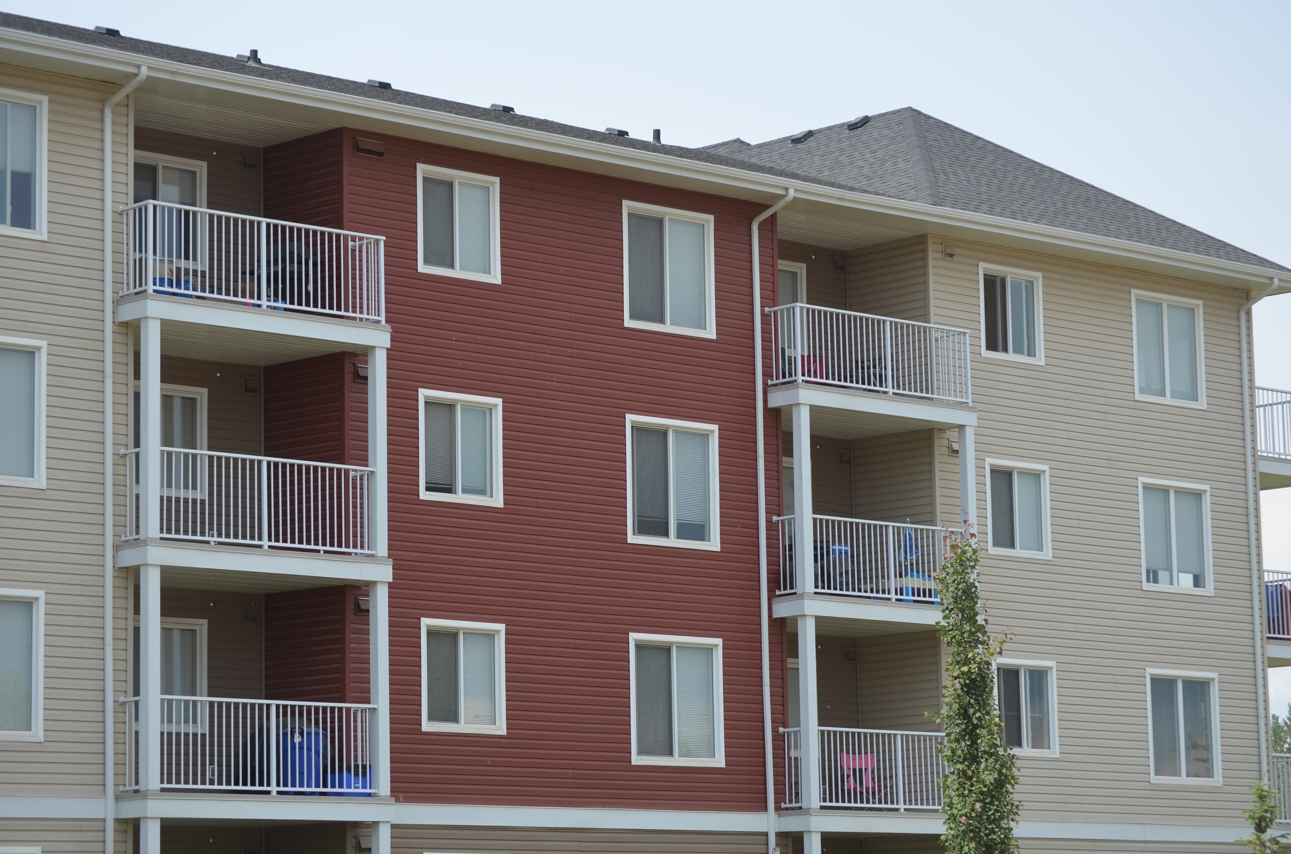
IMPACT OF PROPERTY TAXES AND UTILITIES
A Town of Slave Lake home with an average assessed value of $320,000 will pay $2,633.73 for town property taxes and $151.23 water/wastewater/stormwater/garbage utilities.
This represents a total increase to an average household of $29 per month compared to 2018.

Slide 22
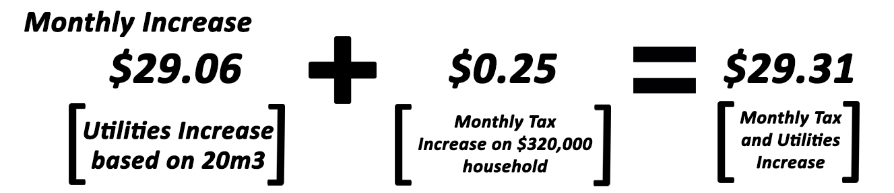
UTILITIES – INCREASE BREAKDOWN

